Slide 1
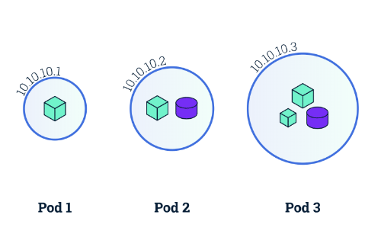
A
MINOR PROJECT
ON
K8s PODS
SUBMIT BY –
RINKU SHARMA
SUBMIT TO –
ASHISH MITTAL

Slide 2
Table of content
Introduction to k8s pods
What are pods
Characteristics of pods
Pod design
Components of pods
Pod management
Conclusion
Hand practice of k8s pods

Slide 3
Introduction to k8s pods
In Kubernetes, a pod is the smallest and most basic unit of deployment. It represents a logical group of one or more containers that are co-located and share the same execution environment. Pods are used to run and manage containerized applications in a Kubernetes cluster

Slide 4
What are pods
The basic building block of k8s
Smallest and simplest unit of deployment in k8s
A logical group of one or more containers that are tighty coupled and share resources

Slide 5
Characteristics of pods
Pods are ephemeral:--
Pods are created ,scheduled and managed by k8s
Pods are mortal:--
They can be terminated and replaced by new instance
Pods have unique IP address within the cluster
Pods share the same network namespace

Slide 6
Pod design
Single-container pods:- Most common use case where a single container runs in a pod
Multi-container pods:- Multiple container tighty coupled and co-located within pod
Sidecar pattern:- Additional container provide support or additional functionality to the main container
Ambassador pattern:- A container acts as an intermediary or proxy for network traffic

Slide 7
Components of pods
1.Pod Spec: Contains metadata, container specifications, and resource requirements.
2.Pod Status: Provides information about the current state of the Pod, such as conditions, container statuses, and events.
3.Pod Network: Enables communication within the cluster and exposes services to external entities.
4.Pod Storage: Defines volumes and storage configurations used by the containers within the Pod.

Slide 8
Pod management
Kubenetes manages the lifecycle of pods,including scheduling,scaling,health checks and recovery
Define pod spwecification using YAML or JSON files
Kubernetes controllers ensure that the desired number of pods running and maintain the desired state

Slide 9
Conclusion
Pods are fundamental unit of deployment in Kubernetes
Pods enable grouping and co-location of container within a single logical entity
Pods provide encapsulation ,scalability and magageability in Kubernetes
deployment

Slide 10
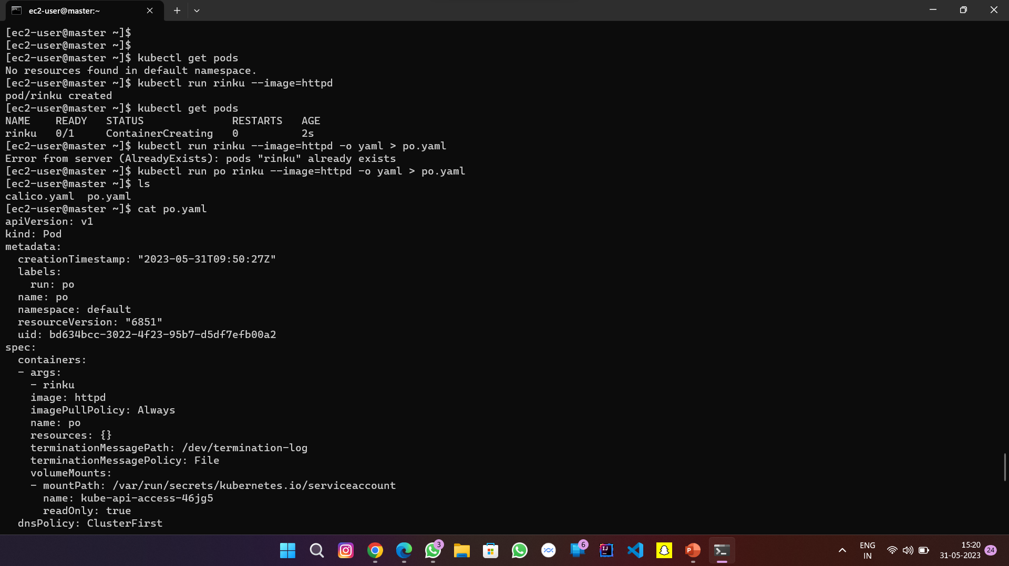
Hand practice of k8s pods

Slide 11
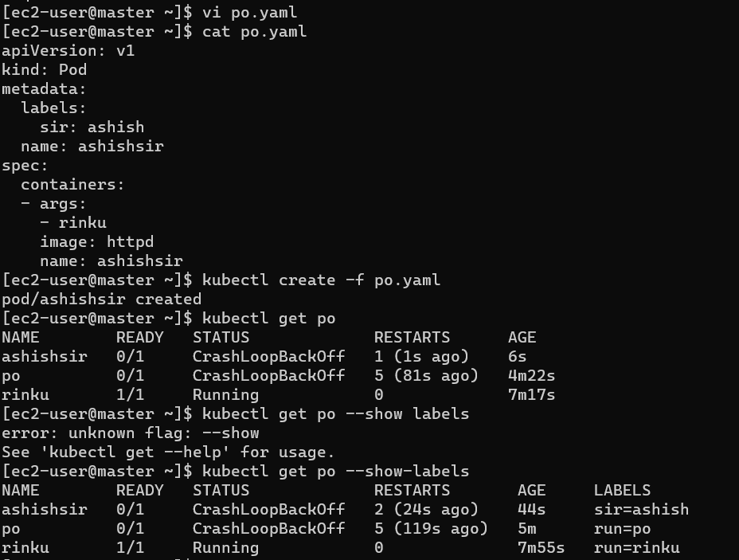

Slide 12
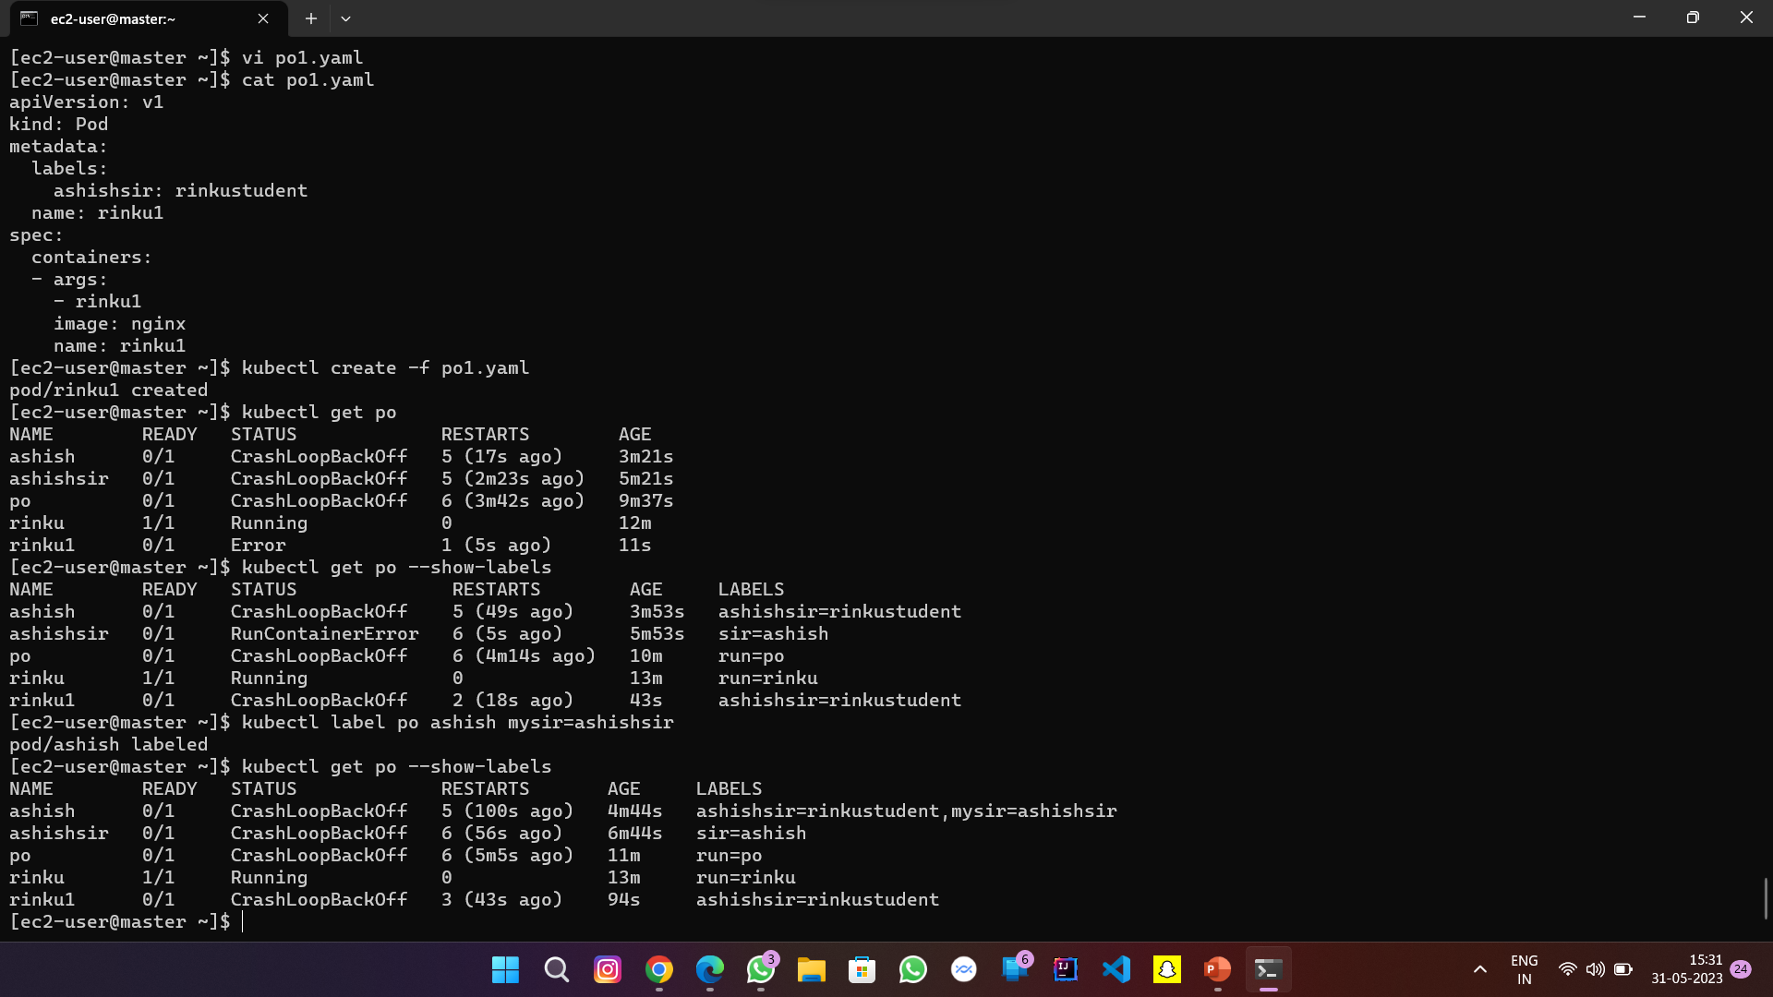

Slide 13
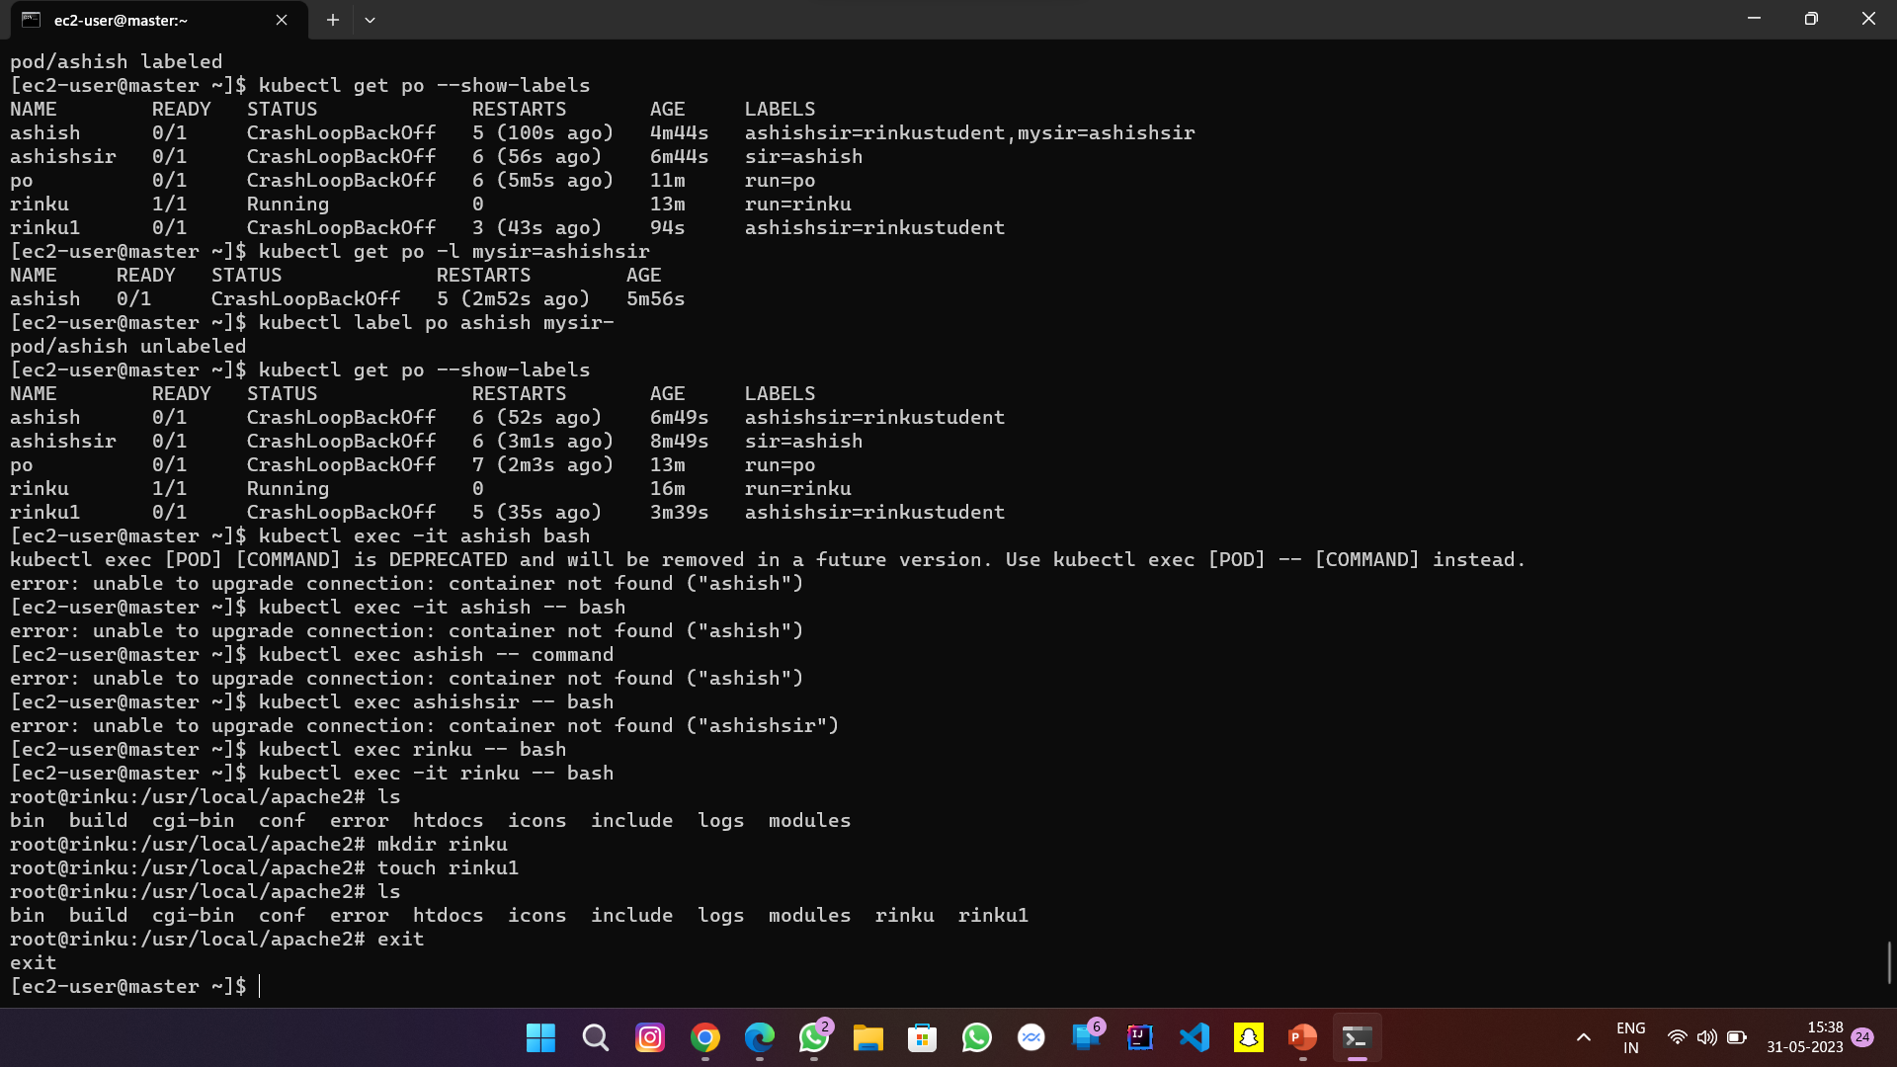

Slide 14
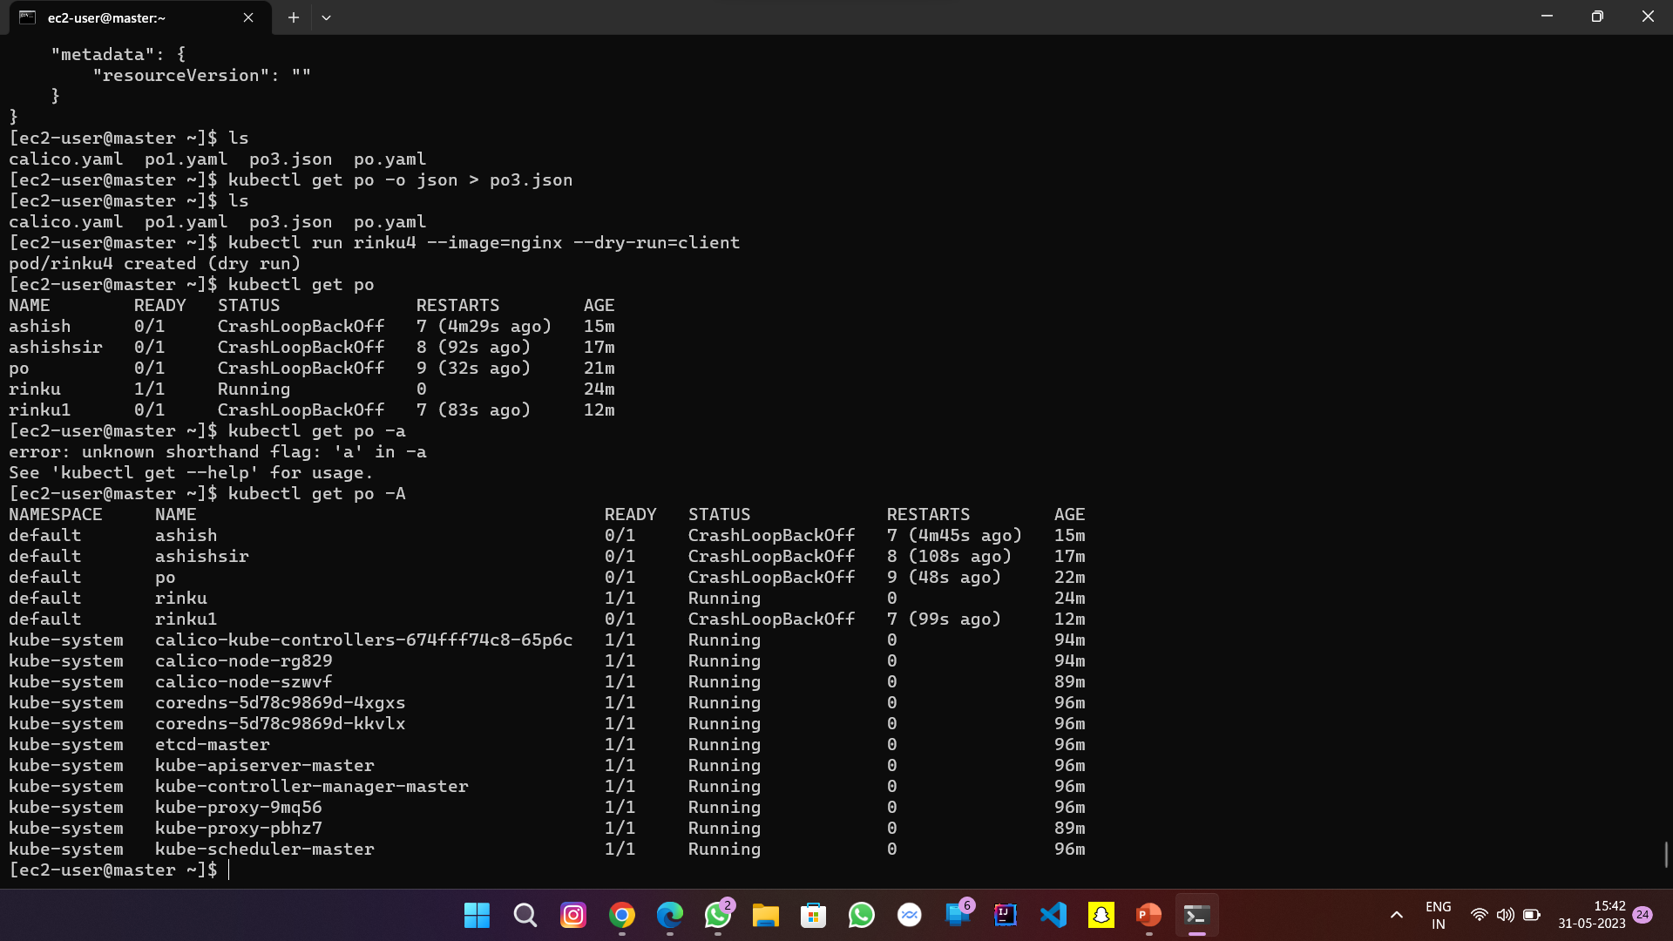

Slide 15
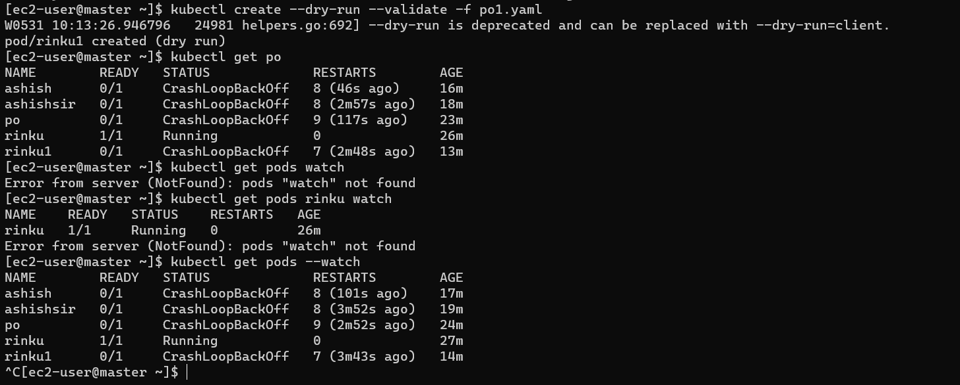

Slide 16
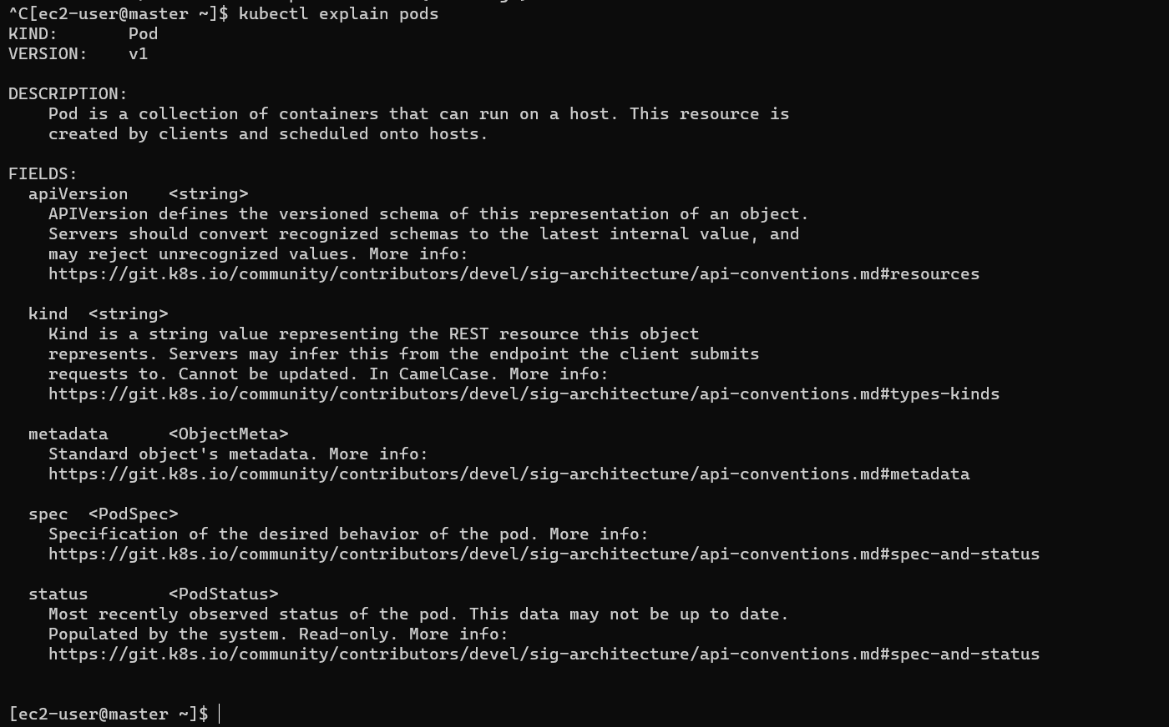

Slide 17
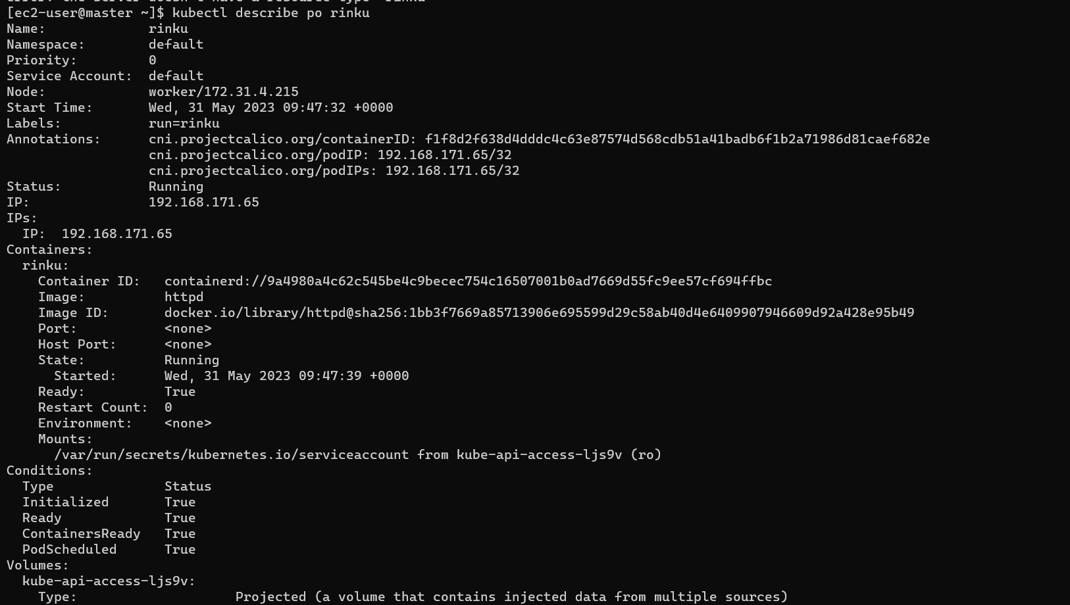

Slide 18
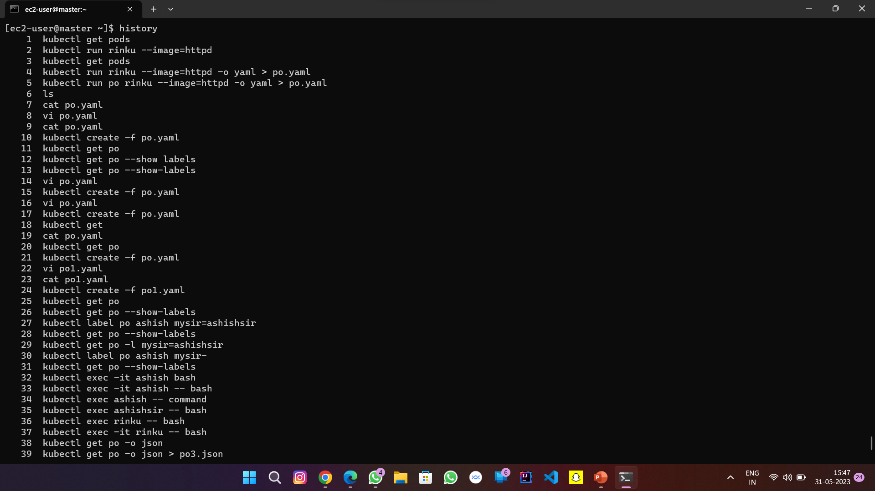

Slide 19
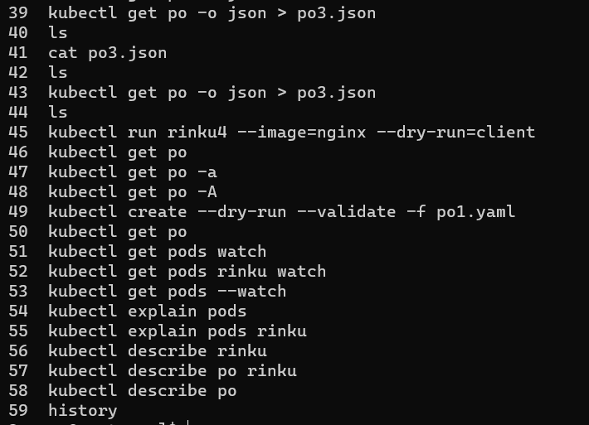

Slide 20


